Slide 1
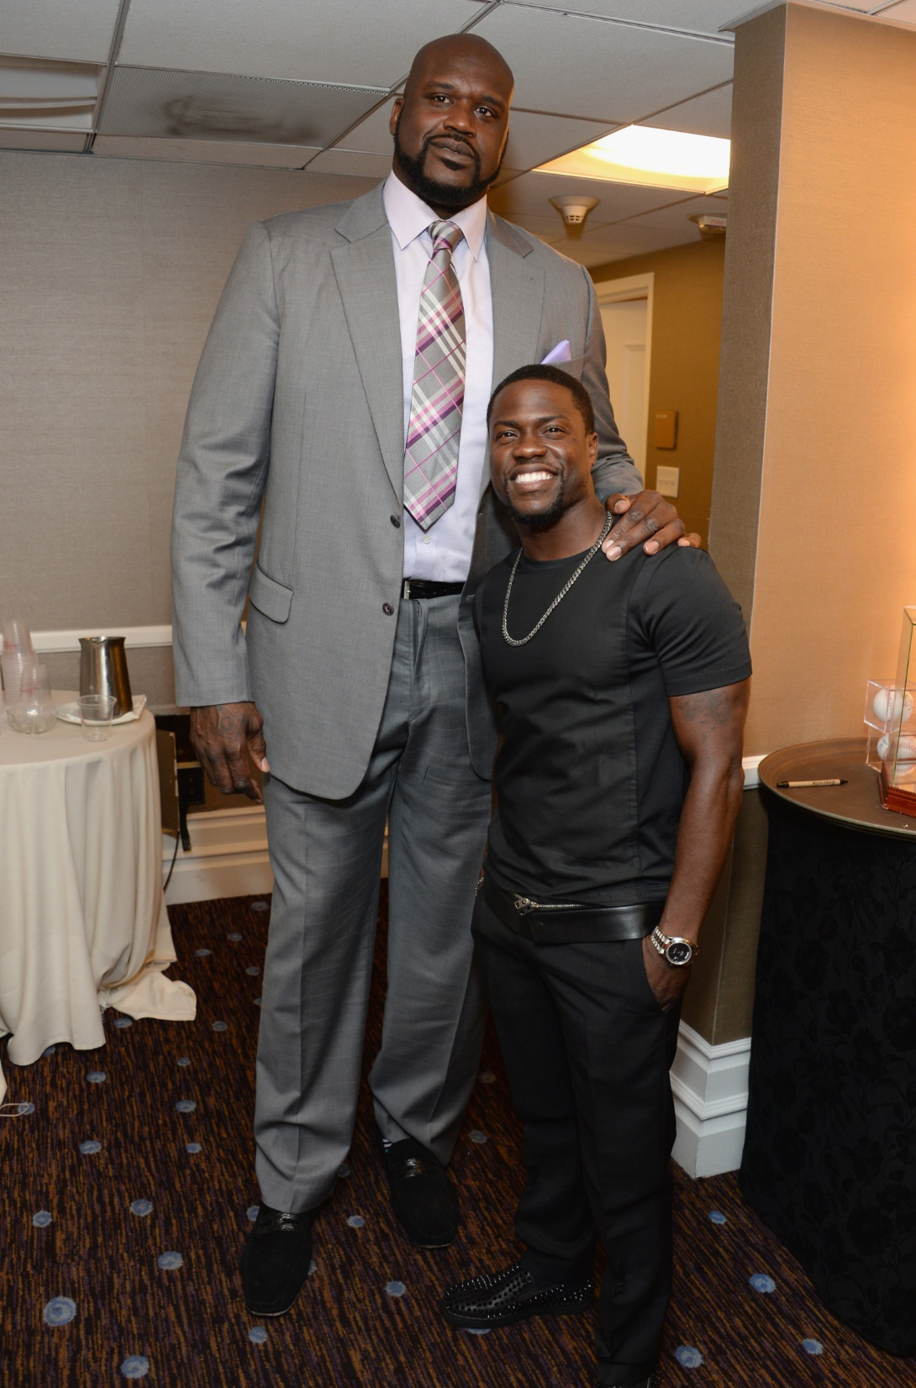
Were there GIANTS
in Noah’s Day?
Genesis 6.1-8
Shaquille O'Neal and Kevin Hart
HuffingtonPost.com

Slide 2
Genesis 6.1-8 NASB: Now it came about, when men began to multiply on the face of the land, and daughters were born to them, ²that the sons of God saw that the daughters of men were beautiful; and they took wives for themselves, whomever they chose. ³Then the LORD said, “My Spirit shall not strive with man forever, because he also is flesh; nevertheless his days shall be one hundred and twenty years.” ⁴The Nephilim were on the earth in those days, and also afterward, when the sons of God came in to the daughters of men, and they bore children to them. Those were the mighty men who were of old, men of renown.

Slide 3
⁵Then the LORD saw that the wickedness of man was great on the earth, and that every intent of the thoughts of his heart was only evil continually. ⁶The LORD was sorry that He had made man on the earth, and He was grieved in His heart. ⁷The LORD said, “I will blot out man whom I have created from the face of the land, from man to animals to creeping things and to birds of the sky; for I am sorry that I have made them.” ⁸But Noah found favor in the eyes of the LORD.

Slide 4
Genesis 6.1-8:
Who are . . .
the sons of God
the daughters of men
the Nephilim
the mighty men who were of old, men of renown

Slide 5
Hebrew Plot Development: Each line formatted
ו-consecutive-imperfect-verb + subject / sentence.

Slide 6
Hebrew Plot Development: Each line formatted
ו-consecutive-imperfect-verb + subject / sentence.
v.1: ו-came to be it / mankind began to multiply on the face of the land and daughters were born to them.
v.2: ו-saw the sons of God / that the daughters of men were beautiful.
v.2: ו-took they / wives for themselves, whomever they chose.
v.3: ו-said Yahweh / “My Spirit ….”

Slide 7
v.1: ו-came to be [imperfect tense verb] it [subject] …
v.2: ו-saw [imperfect tense verb] the sons of God [subject] ...
v.2: ו-took [imperfect tense verb] they [subject] ...
v.3: ו-said [imperfect tense verb] Yahweh [subject] …
v.4: The Nephilim [subject] were [perfect tense verb] …

Slide 8
Theory 1: The sons of God are fallen angels [demons];
the daughters of men are human.
Genesis 6.1-2 NASB: Now it came about, when men began to multiply on the face of the land, and daughters were born to them, that the sons of God saw that the daughters of men were beautiful; and they took wives for themselves, whomever they chose.

Slide 9
Theory 1: The sons of God are fallen angels [demons];
the daughters of men are human.
Job 2.1 NASB: Job 2.1 NASB: Again there was a day when the sons of God came to present themselves before the LORD, and Satan also came among them to present himself before the LORD.
Psalms 29.1 ESV: Ascribe to the LORD,
O heavenly beings, [literally “sons of God”]
ascribe to the LORD
glory and strength.

Slide 10
Theory 1: The sons of God are fallen angels [demons];
the daughters of men are human.
Matthew 5.9 NASB: “Blessed are the peacemakers, for they shall be called sons of God.”
Romans 8.14 NASB: For all who are being led by the Spirit of God, these are sons of God.

Slide 11
Theory 1: The sons of God are fallen angels [demons];
the daughters of men are human.
2 Peter 2.1-9 NET: …For if God did not spare the angels who sinned, but threw them into hell and locked them up in chains in utter darkness, to be kept until the judgment, and if he did not spare the ancient world, but did protect Noah, a herald of righteousness, along with seven others, when God brought a flood on an ungodly world, and if he turned to ashes the cities of Sodom and Gomorrah…

Slide 12
Theory 1: The sons of God are fallen angels [demons];
the daughters of men are human.
Jude 1.6-7 NET: You also know that the angels who did not keep within their proper domain but abandoned their own place of residence, he has kept in eternal chains in utter darkness, locked up for the judgment of the great Day. So also Sodom and Gomorrah and the neighboring towns, since they indulged in sexual immorality and pursued unnatural desire in a way similar to these angels, are now displayed as an example by suffering the punishment of eternal fire.

Slide 13
Theory 1: The sons of God are fallen angels [demons];
the daughters of men are human.
Genesis 6.1-2 NASB: Now it came about, when men began to multiply on the face of the land, and daughters were born to them, ²that the sons of God saw that the daughters of men were beautiful; and they took wives for themselves, whomever they chose.
אִשָּׁה לָקַח = take a wife or take a woman?

Slide 14
Theory 1: The sons of God are fallen angels [demons];
the daughters of men are human.
Genesis 6.3, 5-7 NASB: Then the LORD said, “My Spirit shall not strive with man forever, because he also is flesh; nevertheless his days shall be one hundred and twenty years” … Then the LORD saw that the wickedness of man was great on the earth, and that every intent of the thoughts of his heart was only evil continually. The LORD was sorry that He had made man on the earth, and He was grieved in His heart. The LORD said, “I will blot out man whom I have created from the face of the land…”

Slide 15
Theory 2: The sons of God are descendants of Seth;
the daughters of men are of Cain [or at least pagan].
Genesis 6.1-2 NASB: Now it came about, when men began to multiply on the face of the land, and daughters were born to them, that the sons of God saw that the daughters of men were beautiful; and they took wives for themselves, whomever they chose.

Slide 16
Theory 2: The sons of God are descendants of Seth;
the daughters of men are of Cain [or at least pagan].
In vv.1, 2, 4 אָדָם multiplies and has daughters who are taken.
In vv.3, 5, 6, 7 God judges אָדָם and will blot them out because they are wicked.
In those latter verses, אָדָם refers to all people; can אָדָם then refer only to a subgroup in the other verses?

Slide 17
Theory 3: The sons of God are a dynasty of tyrants [of Cain/Lamech?]; the daughters of men are of Seth.
Genesis 6.1-2 NASB: Now it came about, when men began to multiply on the face of the land, and daughters were born to them, that the sons of God saw that the daughters of men were beautiful; and they took wives for themselves, whomever they chose.

Slide 18
Theory 4: The sons of God are leaders possessed by demons; daughters of men are human.
Genesis 6.1-2 NASB: Now it came about, when men began to multiply on the face of the land, and daughters were born to them, that the sons of God saw that the daughters of men were beautiful; and they took wives for themselves, whomever they chose.

Slide 19
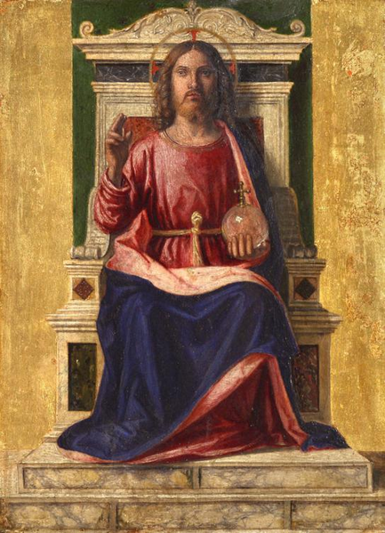
Matthew 24.37-39 NET: For just like the days of Noah were, so the coming of the Son of Man will be. For in those days before the flood, people were eating and drinking, marrying and giving in marriage, until the day Noah entered the ark. And they knew nothing until the flood came and took them all away. It will be the same at the coming of the Son of Man.

Slide 20
Genesis 6.4 NASB: The Nephilim were on the earth in those days, and also afterward, when the sons of God came in to the daughters of men, and they bore children to them. Those were the mighty men who were of old, men of renown.

Slide 21
Genesis 6.4 NASB: The Nephilim were on the earth in those days, and also afterward, when the sons of God came in to the daughters of men, and they bore children to them. Those were the mighty men who were of old, men of renown.
נְפִלִים = Nephilim = ?
נָפַל = “to fall,” “to collapse,” “to die in battle,”
“to be inferior,” “to fall upon/raid,” “to be born.”
γίγαντες in Septuagint = mighty ones or giants.

Slide 22
Were there GIANTS
in Noah’s Day?
Shaquille O'Neal and Kevin Hart
HuffingtonPost.com

Slide 23
Genesis 6.5-8 NASB: Then the LORD saw that the wickedness of man was great on the earth, and that every intent of the thoughts of his heart was only evil continually. The LORD was sorry that He had made man on the earth, and He was grieved in His heart. The LORD said, “I will blot out man whom I have created from the face of the land, from man to animals to creeping things and to birds of the sky; for I am sorry that I have made them.” But Noah found favor in the eyes of the LORD.
Study materials available at groben.com

